Slide 1
Detecting music genre based on song lyrics
Paweł Gołąbek
Semestr: 6.
Studia Stacjonarne
Przedmiot: Biologically Inspired Artificial Intelligence
Prowadzący: dr inż. Grzegorz Baron
Data Prezentacji: 18.06.2024

Slide 2
Goal of the project
The goal of the project was to create a model that detects one of many music genres based on song lyrics.
I didn't find any ready-made solutions to this problem on Kaggle, but I don't rule out that someone may have created such a model before.
Pytorch based

Slide 3
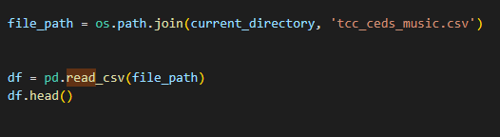
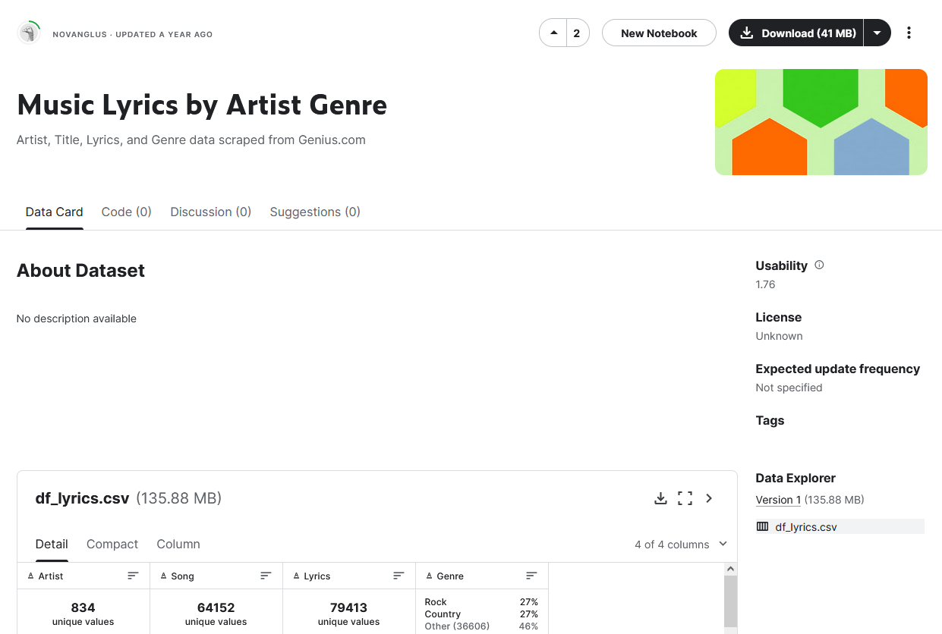
Database
The database used was based on texts obtained from one of the largest lyrics websites, Genius.com.
Compared to other databases, it was distinguished by a large collection of organized data with at least several music genres directly linked to the lyrics.
64152 songs

Slide 4
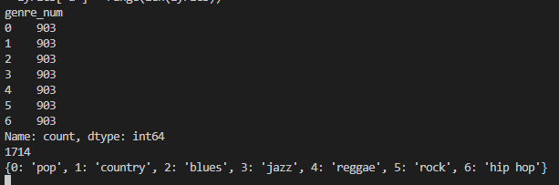
Prepared data
Data has been downsized randomly for uniform distribution of data
I didn’t want to delete or merge any genres so I downscaled to least popular one in the data provided
This leaves us with 903 songs per genre

Slide 5
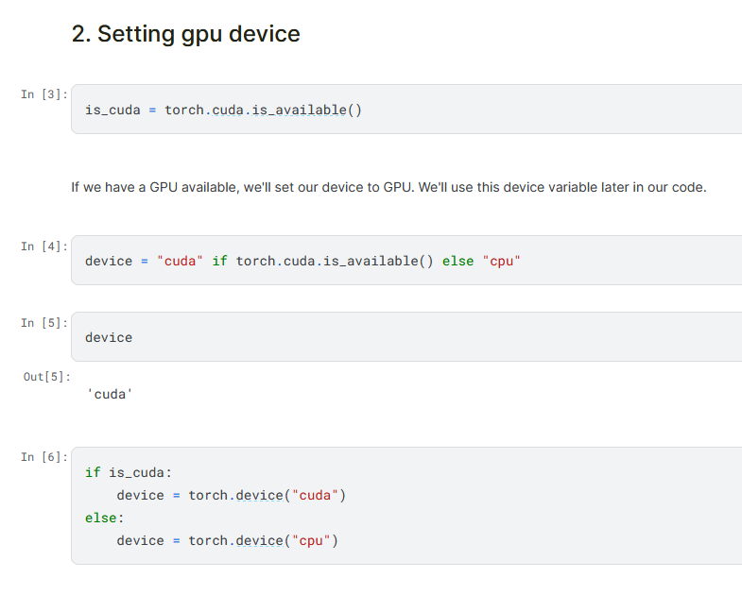

Slide 6

Model was based on model made for song topic classification
Similar goal in mind
The same dataset
Also pytorch

Slide 7
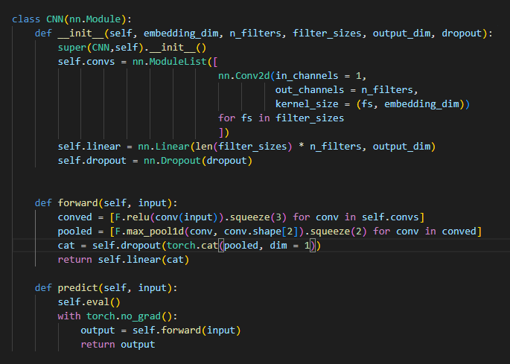
Model for the first few tests

Slide 8
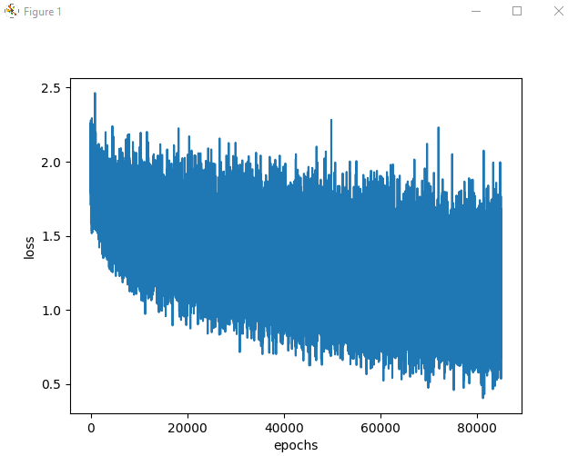
First test
60 epochs
Final accuracy: 0.625
Batch size: 32

Slide 9
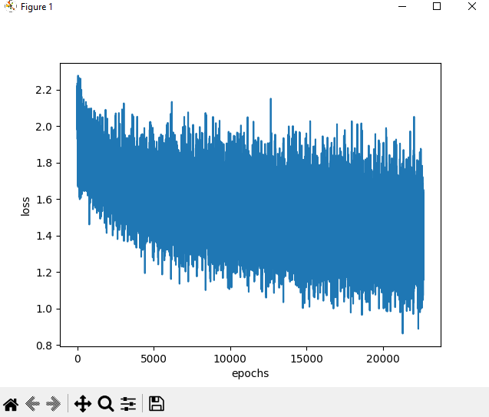
Second test
Final Accuracy: 0.55
20 epochs
Batch size: 20

Slide 10
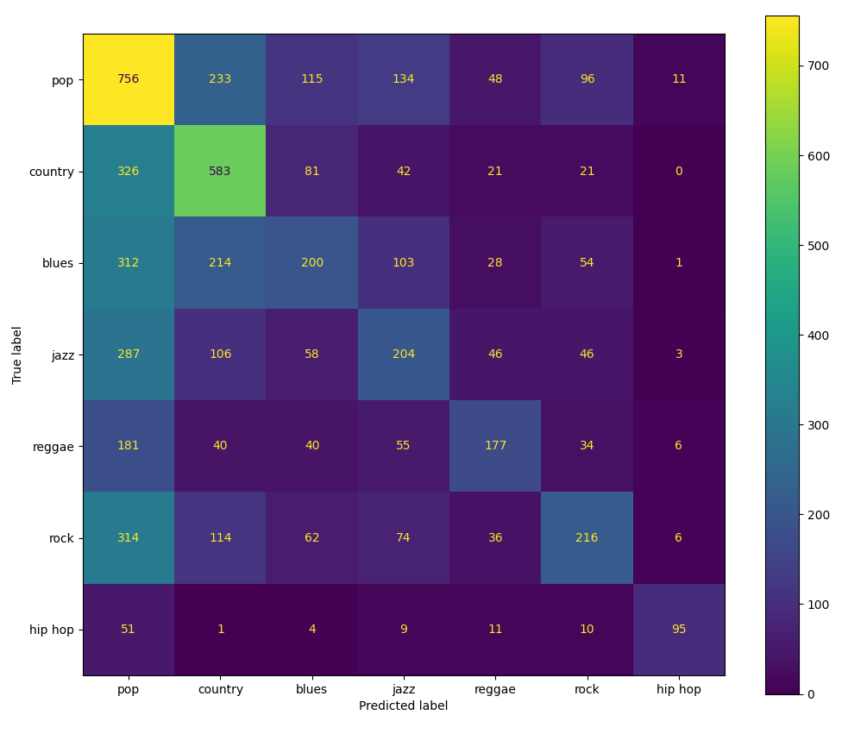
Curiosity: confusion graph without downscaling

Slide 11
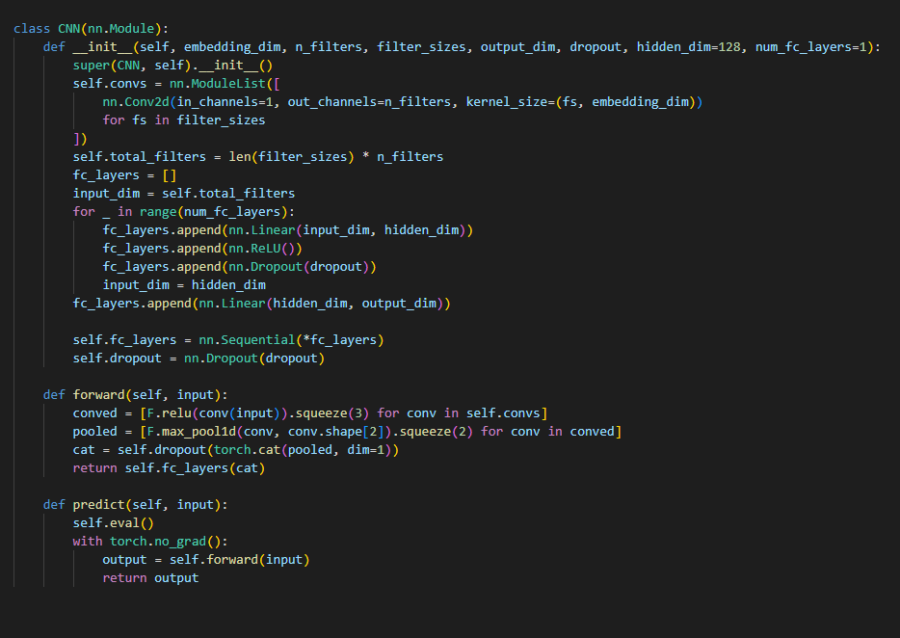
New model

Slide 12
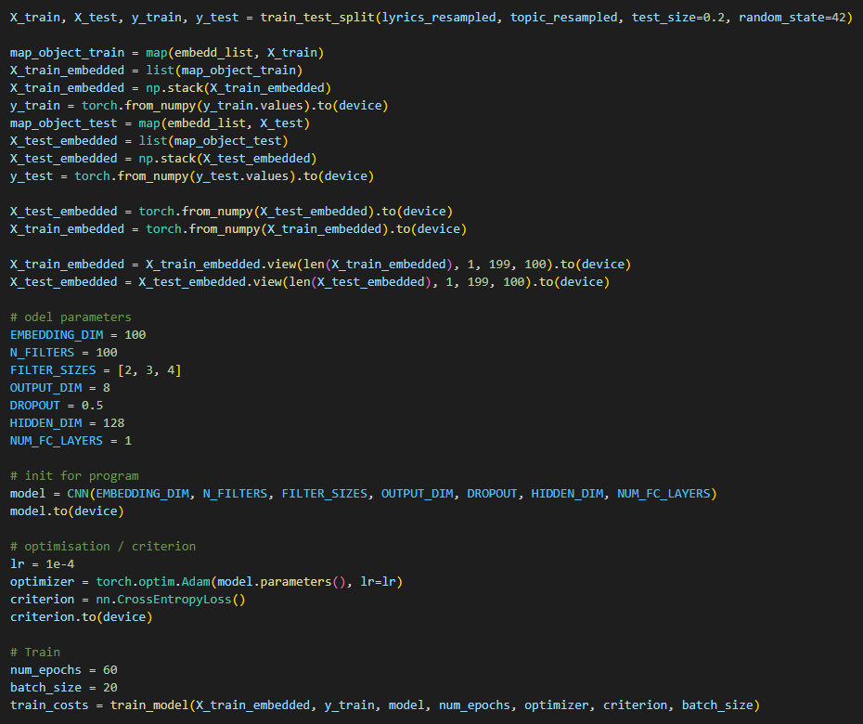
Usage

Slide 13
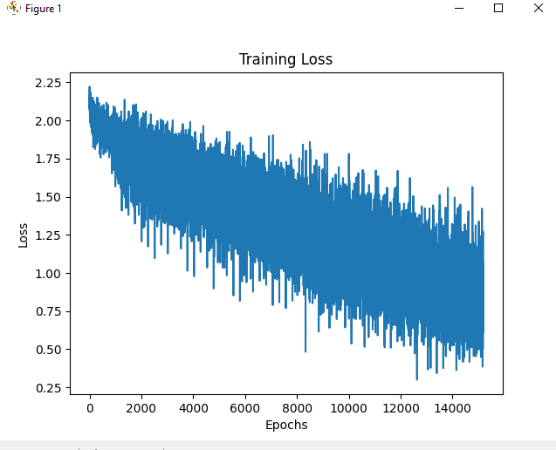
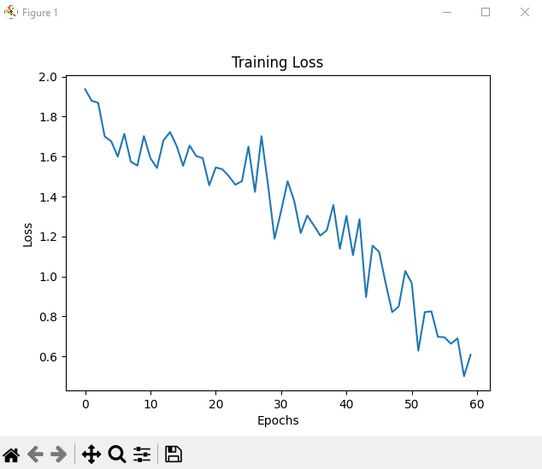
After changes
Final Results:
Loss: 0.5051172
Test accuracy:0.875

Slide 14
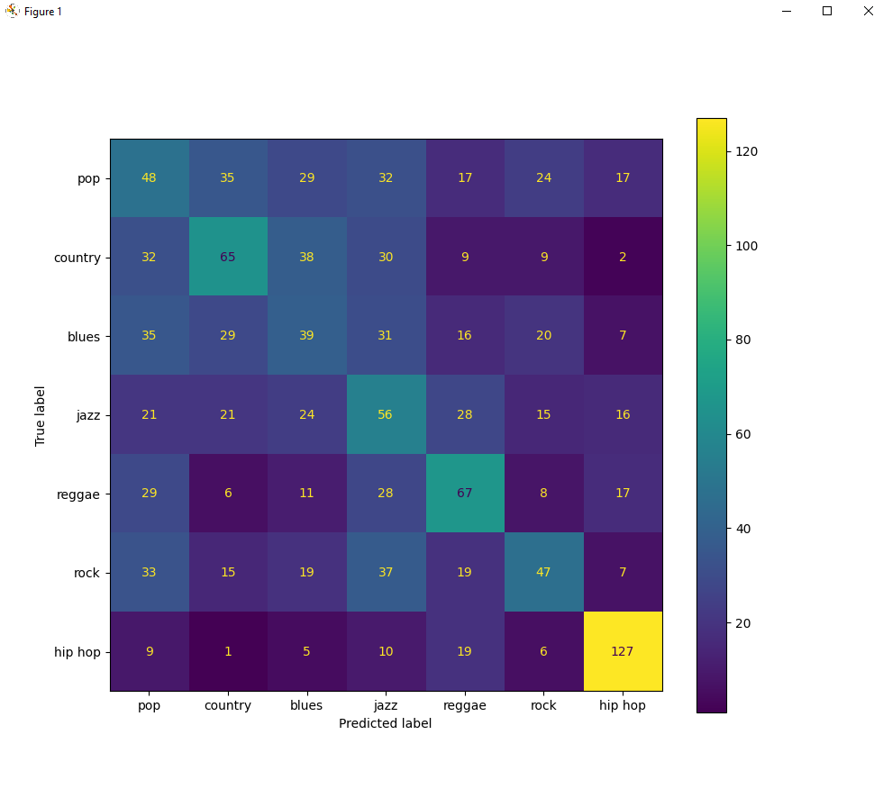
After changes

Slide 15
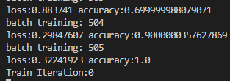
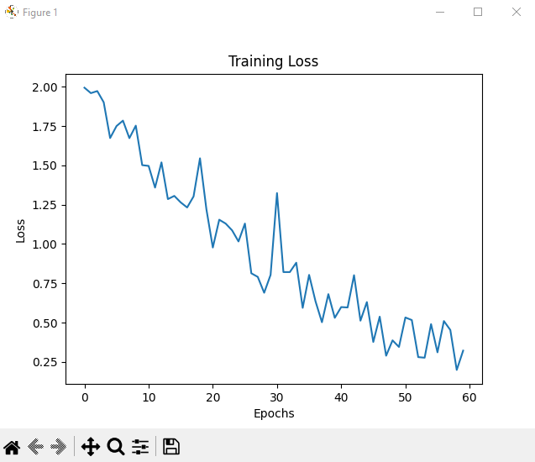
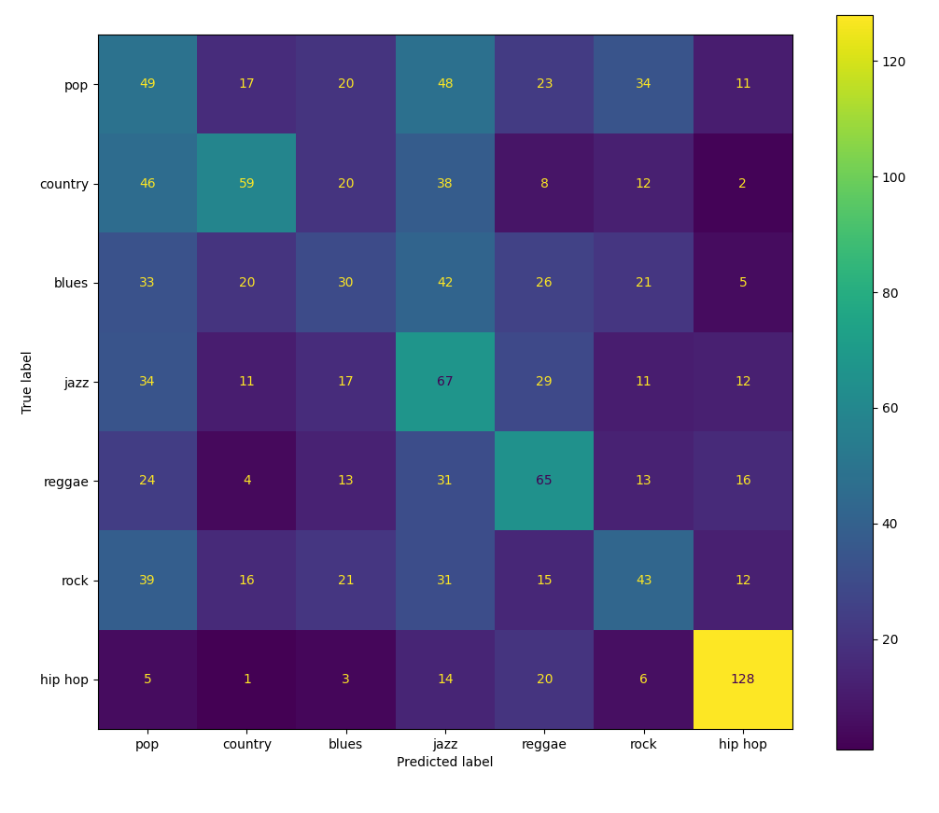
Batch size: 10

Slide 16
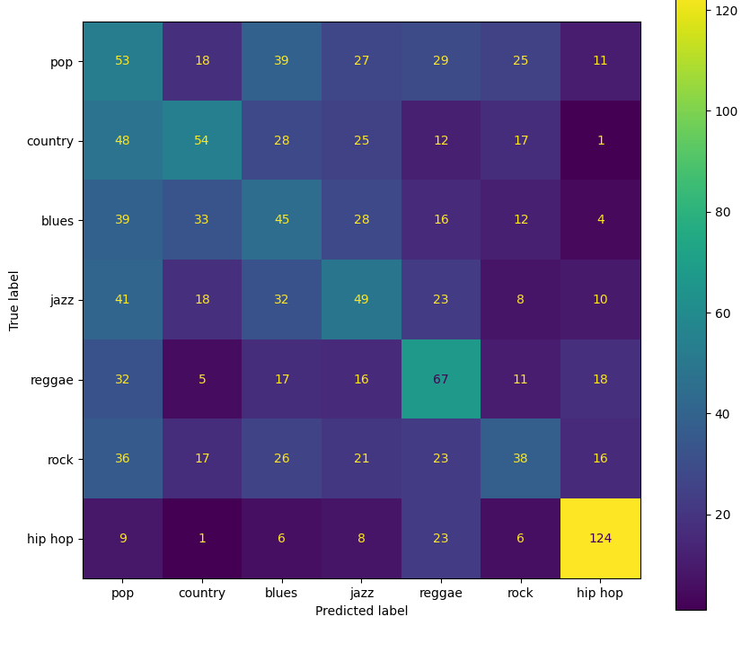
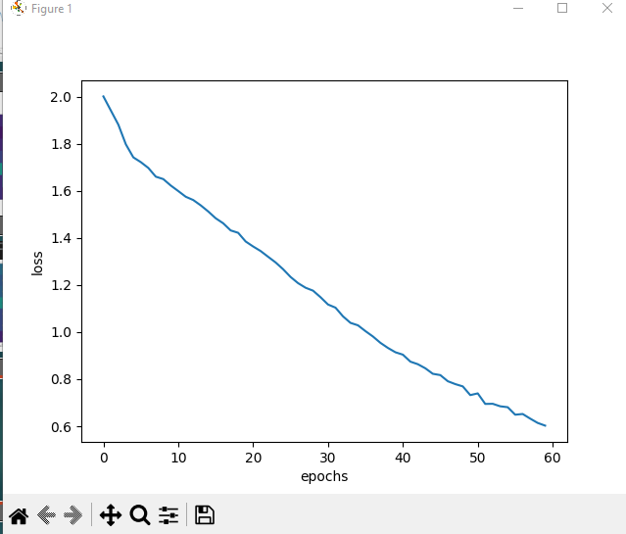
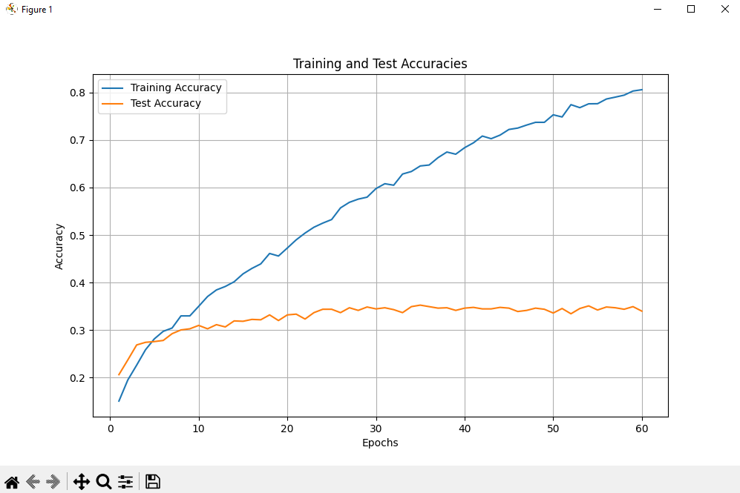
Batch size: 10

Slide 17
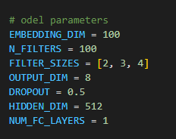
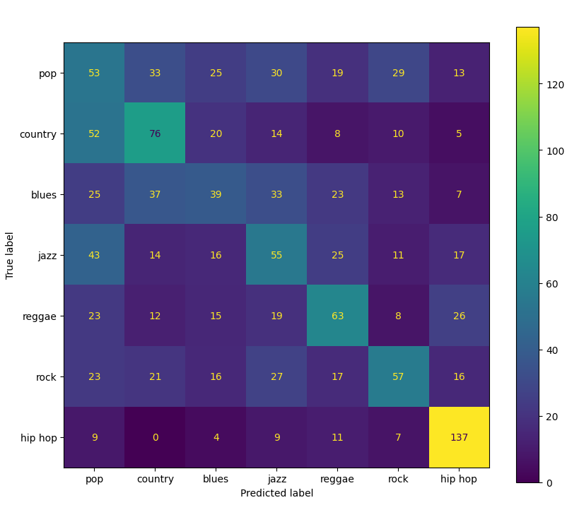

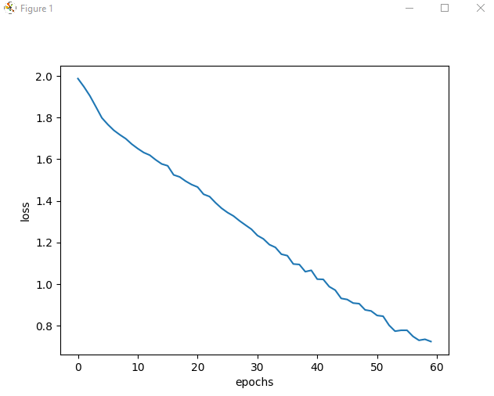
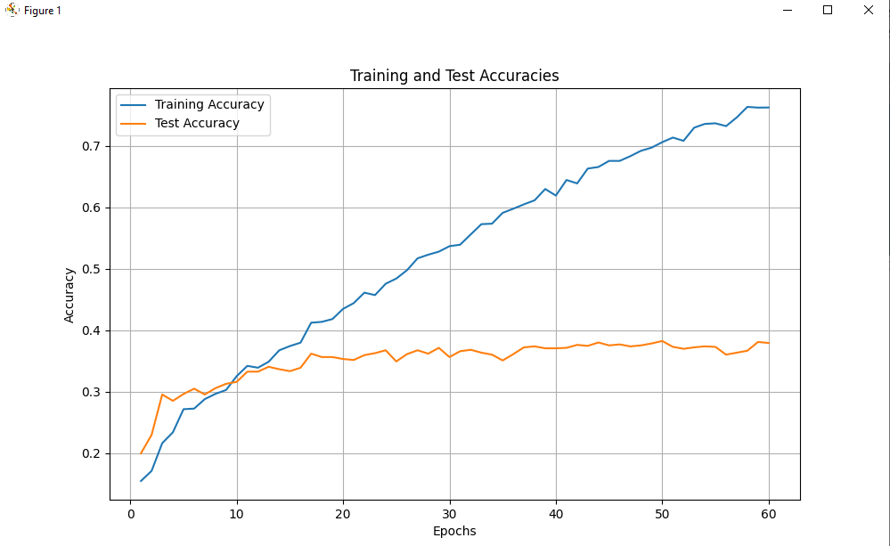
Batch 30

Slide 18
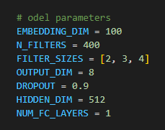
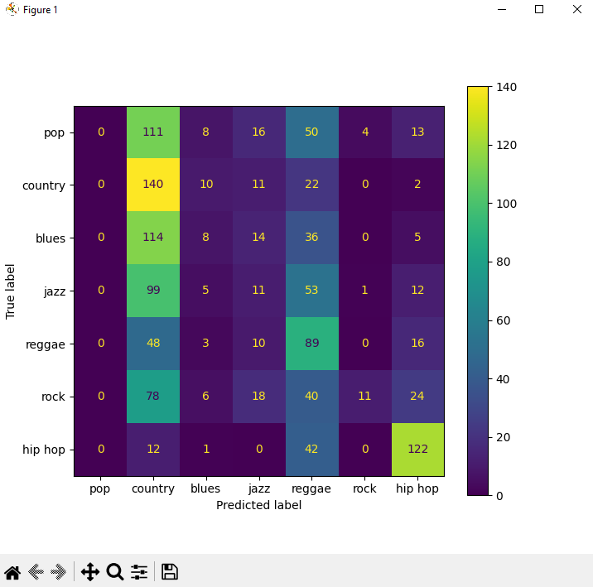
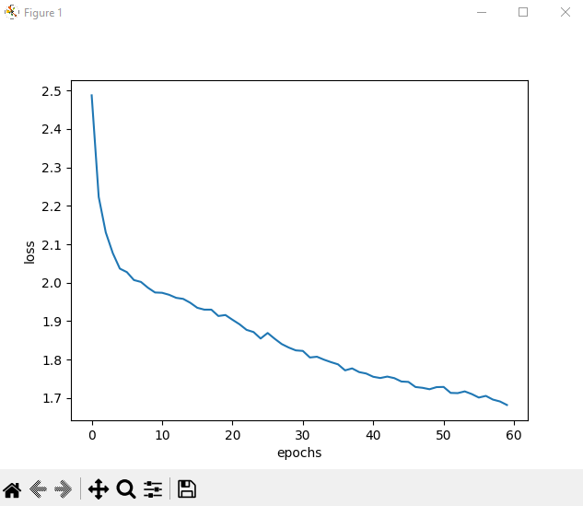
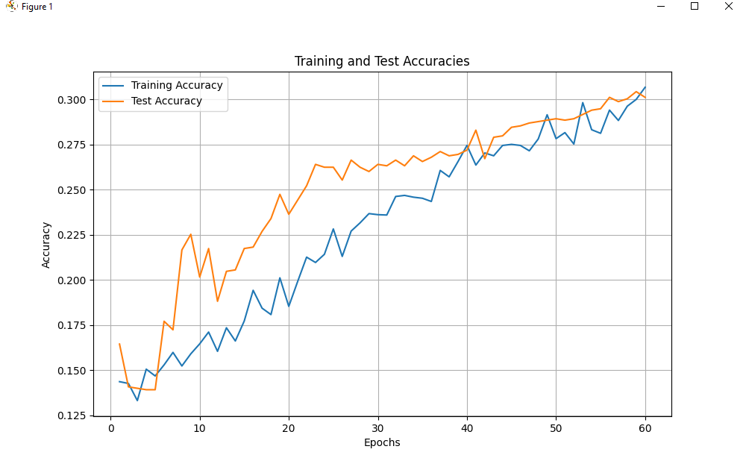
More tests?

Slide 19
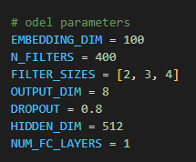
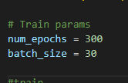
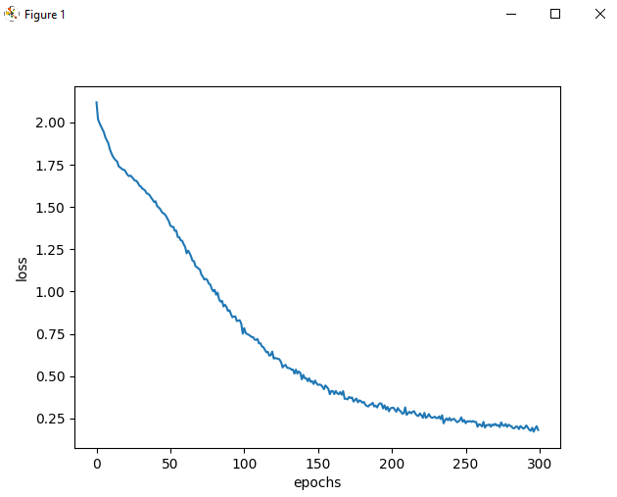
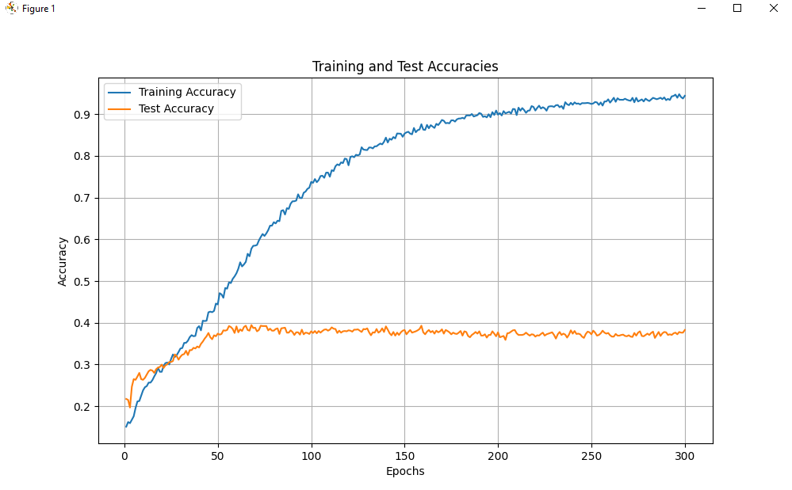
Long test

Slide 20
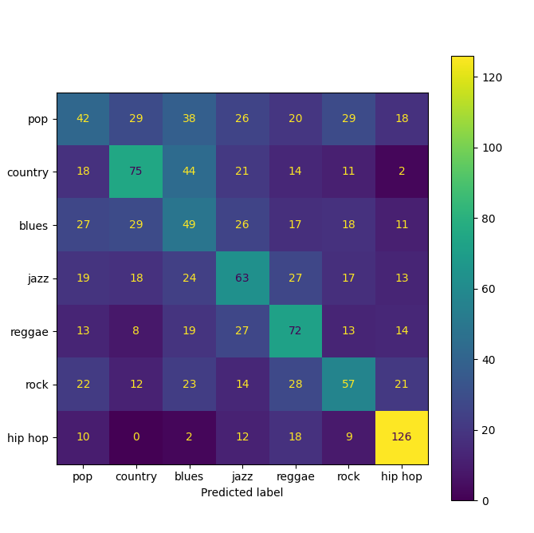
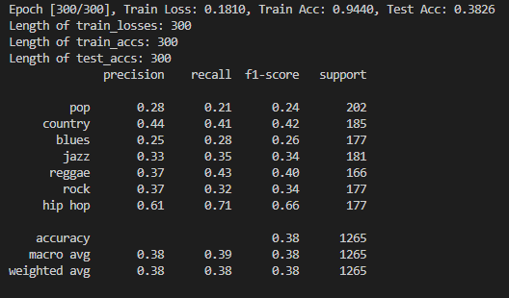
Final Confusion Matrix

Slide 21
The end

